Slide 1
Monolithic Concrete Construction using Aluminum form work system
By
Dr. Rajiv Goel
AMIE, M.E.(Structural Engineering), Ph.D.
IRSE, Ex Deputy Chief Engineer/Indian Railway
Director
Arocon Real Esatate Pvt. Ltd.
Atkins Infraprojects & Consultants Pvt. Ltd.
Skardi Realtech Pvt. Ltd.
Ph: 9212318500, 9582282277, Email: rajivgoel.irse@gmail.com

Slide 2
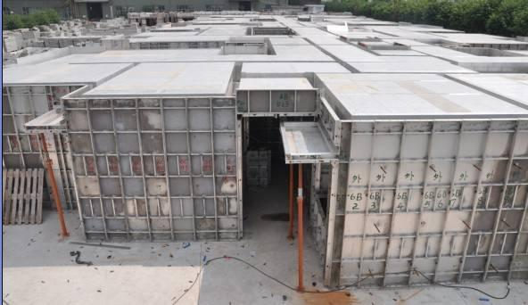

Slide 3
History
The Aluminum Formwork System was developed by W. J. Malone, a Canadian Engineer in the late 1970s as a system for constructing low–cost housing unit in developing countries. The units were to be of cast-in-situ concrete, with load bearing walls using a formwork of aluminum panels. To be erected by the hundreds, of a repetitive design, the system ensured a fast and economical method of construction.
The in-situ construction of all walls and partitions reduces the requirement for follow-on wet trades. The concrete surface finish produced with the aluminium forms allows achievement of a high quality wall finish without the need for internal or external plastering.

Slide 4
Aluminium Formwork System
Aluminium Formwork System is a construction system for forming cast in place concrete structure of a building. It is also a system for scheduling and controlling the work of other construction trades such as steel reinforcement, concrete placement and mechanical and electrical conduits.
The System is fast, simple, adaptable and very cost effective. It is unique because it forms all of the concrete in a building including walls, floor slabs, columns, beams, stairs, window hoods, balconies and various decorative features in exact accordance with the architects' design. The dimensional accuracy of the concreted work also results in consistent fittings of doors and windows. The smooth–off form finish of the concrete eliminates the need for costly plastering.
Aluminium Formwork System provides Aluminium Formwork for RCC load bearing or RCC framed multi-storied buildings and enables the walls and slabs to be poured in the same operation. These increases efficiency and also produces an extraordinarily strong structure with excellent concrete finish. Due to the fine tolerance achieved in the machined metal formwork components, consistent concrete shapes and finishes are obtained floor after floor. This allows plumbing and electrical fittings to be prefabricated with the certain knowledge that there will be an exact fit when assembled. Unlike other construction systems, Formwork Systems of aluminium forms can be erected by unskilled labour and without the need for hoisting cranes. The largest panel weighs not more than 25 Kg which means it can be handled by a single worker.

Slide 5
TECHNOLOGY
Aluminium Formwork System is highly suited to load bearing wall construction whereas traditional formwork consisting of plywood and timber is not suitable to the high pressures of fresh concrete on the wall.
COST: Use of this formwork in load bearing design gives an average of 15 per cent cost saving in the structure of the building and increased usable floor space of 8 per cent over RCC design.
TIME: For 100 per cent work, construction through slab beam wall construction takes X time and through Aluminium Formwork technology the time required is 1/6th of the X time.
ENVIRONMENT FRIENDLY: The technology is environment friendly as there is no use of timber. The formwork gives the box or cellular design resulting in the walls giving support to the super structure in two directions. As a result, the structures are more resistant to earthquakes than the traditional RCC column and beam designs.
LIFTING: As the Aluminium Formwork is lightweight, no tower cranes are required for the same unlike in tunnel framework.
LABOURS: Due to simplicity of the assembly, only unskilled labours are required with minimal supervision.
REPETITIONS: The Aluminium Formwork System is removable and can be reused hundreds of times with little maintenance.
SCRAP VALUE: Moreover, the requirement of steel is also reduced in this technology as aluminium has a higher scrap value.

Slide 6
SIMPLE ASSEMBLY SYSTEMS
The simplicity of Aluminium Formwork and the repetitive nature of the assembly process make it possible to accurately program construction sequences and thus cycle times well in advance.
In addition, this enables the unskilled labor to work with the formwork, therefore reducing the burden on skilled labor when this is in short supply.
On leaving the factory, all panels are clearly labeled to ensure that they are easily identifiable on sit
PIN AND WEDGE SYSTEM
The panels are held in position by a simple pin and wedge system that passes through holes in the outside rib of each panel.
QUICK STRIP PROP HEAD
One of the principal technical features which enables this speed to be attained using a single set of formwork panels is the unique V shaped prop head which allows the 'quick strip' to take place whilst leaving the propping undisturbed. The deck panels can therefore be reused immediately.

Slide 7
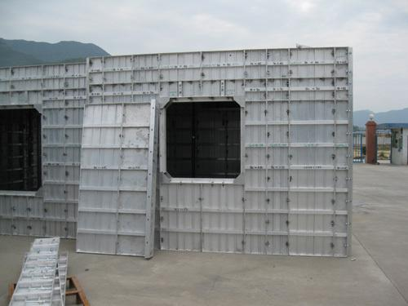

Slide 8
SPEED and QUALITY
One of the principal technical features which enables this speed to be attained using a single set of formwork panels is the unique V shaped prop head which allows the 'quick strip' to take place whilst leaving the propping undisturbed. The deck panels can therefore be reused immediately.
The in-situ construction of all walls and partitions reduces the requirement for follow-on wet trades.
The concrete surface finish produced with the aluminium forms allows achievement of a high quality wall finish without the need for extensive plastering.
Doors and windows are formed in position, with this high degree of precision items such as door and window frames can be directly installed on site with minimal re-sizing required.
High quality Aluminium Formwork panels ensure consistency of dimensions.
On the removal of the Formwork mould, a high quality concrete finish is produced to accurate tolerances and verticality.
The high tolerance of the finish means that no further plastering is required.
Typically a 3mm to 4mm skim coat is applied internally prior to finishing and a 6 mm build up coat prior to laying tiles.

Slide 9
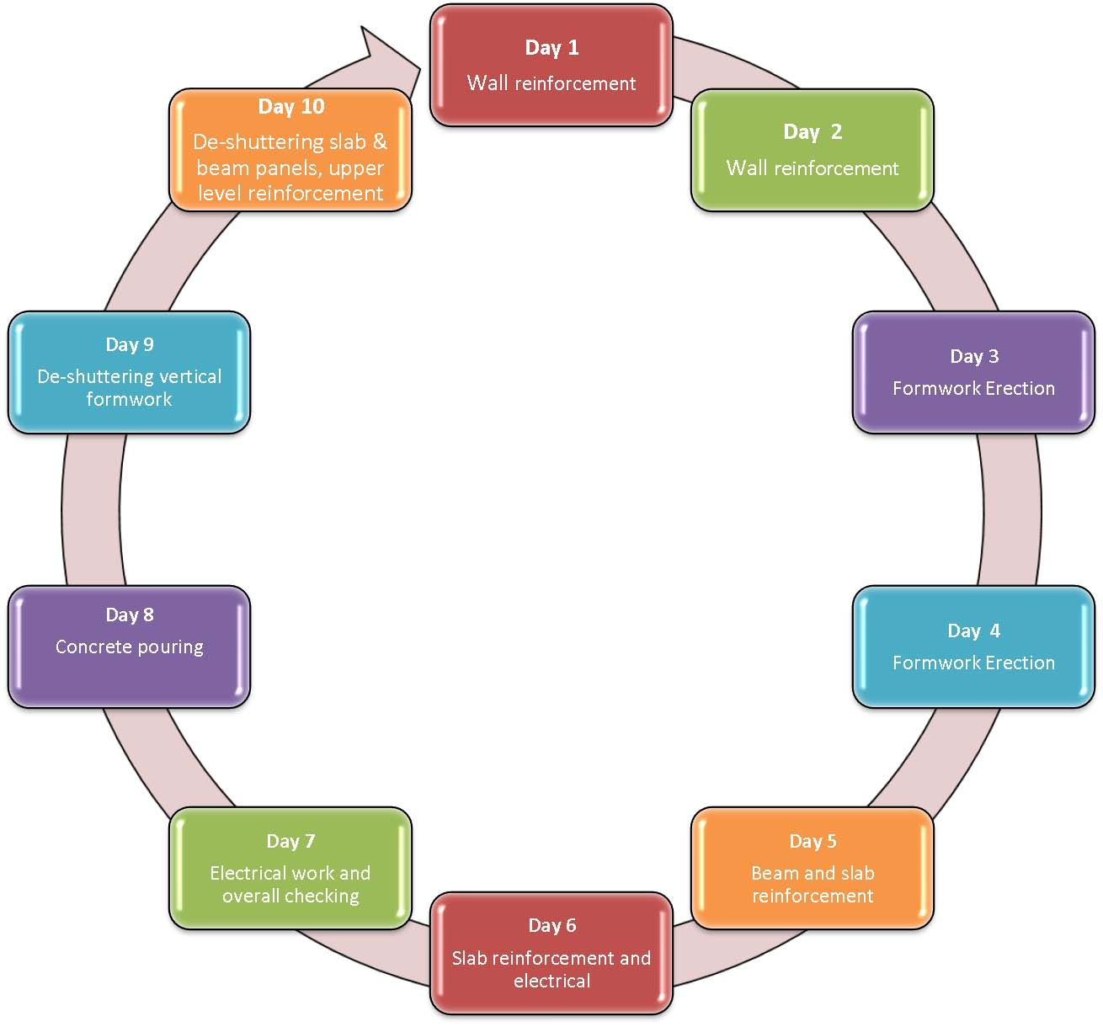
Cycle of Construction In Aluminium Shuttering Technology

Slide 10
Necessity of the Aluminium Form work System
Rapid urbanization has resulted in a geometric increase in the housing demand, which cannot be fulfilled using conventional materials and methods of construction.
The traditional or conventional method of construction for mass housing & high rise buildings is comparatively, a slow process and has limited quality control, particularly when a large size project is involved.
It is therefore obligatory to work out a method or a scheme where the speed and quality of construction are controlled automatically by a systematic approach.
Therefore Aluminium Formwork System (AFS) identified to be suitable for Indian conditions for mass housing construction where quality and speed can be maintained at a reasonably high level

Slide 11
Advantages of
Aluminium formwork System
No Plastering required.
Savings on overhead expenses due to speedy construction (3-4 floors per month).
Monolithic crack free structures.
Doesn't require timber or plywood for construction activities.
Casting of walls and slabs always simultaneously hence total system forms the complete concrete structure.
Floor slab forms removed without moving props.
Earthquake resistance of resulting structures increases manifold.
The Formwork is specifically designed to allow rapid construction on all types of architectural layouts and custom-designed to suit project requirements.
The system becomes cost effective where there is considerable repetition of floor layouts on a project such as in the case of low cost mass housing.
After the 50 cycles of reusing of this formwork system we will reach the breakeven point of the conventional formwork cost.

Slide 12
Advantages of
Aluminium formwork System
Unsurpassed construction speed with High quality finish.
Eliminates plastering, saves almost 50 percent construction time.
The system becomes cost effective where there is considerable repetition of floor layouts on a project such as in the case of low cost mass housing.
Panels can be re used up to 200 times or even more.
Erected using semiskilled labour.
Requires no cranes or heavy lifting equipment.
Suitable for low as well as high rise buildings.
No need to use any timber or plywood.
The resulting structures are highly durable and this ensures that the expenditure on maintenance is kept to a minimum.

Slide 13
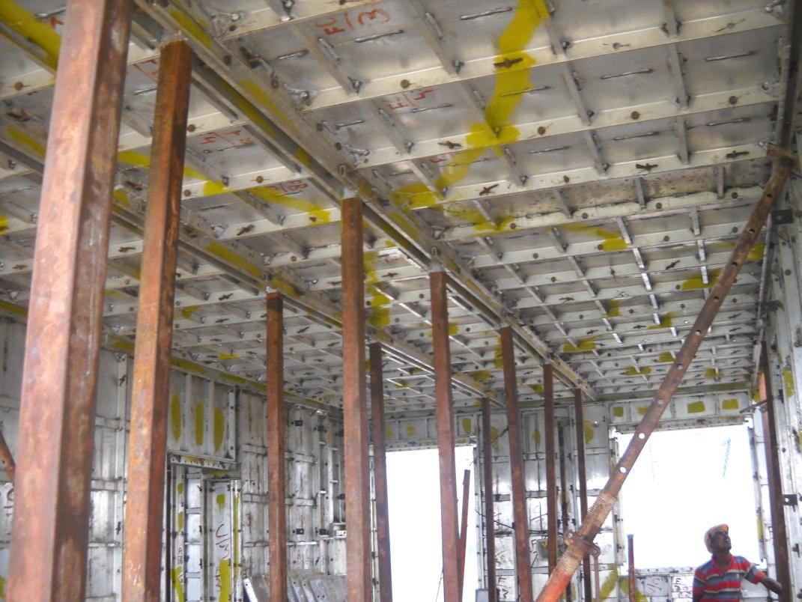

Slide 14
RELATIVE COMPARISON OF IN–SITU ALUMINIUM FORM
SYSTEM WITH CONVENTIONAL CONSTRUCTION
Sl. No | FACTOR | CONVENTIONAL FORM WORK | IN – SITU ALUMINIUM FORM WORK | REMARKS
1 | Quality | Normal | Superior In – Situ casting of whole structure and all walls and slabs are casted in one continuous operation, using controlled concrete mixers obtained from central batching, mixing plants and mechanically placed through concrete buckets using crane and compacted in leak proof moulds using high frequency vibrators | Superior quality in Large and low cost systematic group housing

Slide 15
RELATIVE COMPARISON OF IN–SITU ALUMINIUM FORM
SYSTEM WITH CONVENTIONAL CONSTRUCTION
Sl. No | FACTOR | CONVENTIONAL FORM WORK | IN – SITU ALUMINIUM FORM WORK | REMARKS
2 | Speed of construction. | The pace of construction is slow due to step by step completion of different stages of activity the masonry is required to be laid brick by brick, Erection of formwork, Concreting and deshuttering forms is a two week cycle. The plastering and other finishing activities can commence only thereafter. | In this system, the walls and floors are cast together in one continuous operation in matter of few hours and in built accelerated curing overnight enable removal and re-use of forms on daily cycle basis. | System of construction is much faster.

Slide 16
RELATIVE COMPARISON OF IN–SITU ALUMINIUM FORM
SYSTEM WITH CONVENTIONAL CONSTRUCTION
Sl. No | FACTOR | CONVENTIONAL FORM WORK | IN – SITU ALUMINIUM FORM WORK | REMARKS
3 | Aesthetics. | In the case of RCC structural framework of column and beams with partition brick walls is used for construction, the columns and beams show unsightly projections in room interiors. | The Room – Sized wall panels and the ceiling elements cast against steel plates have smooth finishing and the interiors have neat and clean lines without unsightly projections in various corners. The walls and ceilings also have smooth even surfaces, which only need colour/white wash
4 | External finishes. | Cement plastered brickwork, painted with cement based paint. Finishing needs painting every in three years. | Textured / pattern coloured concrete facia can be provided. This will need no frequent repainting. | Permanent facia finishes feasible with minor extra initial cost

Slide 17
RELATIVE COMPARISON OF IN–SITU ALUMINIUM FORM
SYSTEM WITH CONVENTIONAL CONSTRUCTION
Sl. No | FACTOR | CONVENTIONAL FORM WORK | IN – SITU ALUMINIUM FORM WORK | REMARKS
4 | Consumption of Cement | Normal | Consumption somewhat more than that used in conventional structures. | Although greater consumption Strength and Durability is also more.
5 | Consumption of Reinforcing Steel | Reinforcing steel required is less as compared to the in situ construction as RCC Framework uses brick wall as infill. | It may however will be slightly more than corresponding load bearing brick wall construction for which, requirements of IS 456 is less and we need to provide minimum steel even in the non load bearing walls. | Steel requirement is more as it is required for the shear wall construction. But shear wall construction increases the strength against earthquakes.

Slide 18
Maintenance requirement of Monolithic Concrete structures
CONVENTIONAL FORM WORK | IN – SITU ALUMINIUM FORM WORK | REMARKS
In maintenance cost, the major expenditure is involved due to : Repairs and maintenance of plaster of walls /ceiling etc. Painting of outer and inner walls Leakages due to plumbing and sanitation installation | The walls and ceiling being smooth and high quality concrete repairs for plastering and Seepage are not at all required frequently. | It can be concluded that Maintenance cost is negligible.

Slide 20
Thank you

